Slide 1

CMR COLLEGE OF ENGINEERING & TECHNOLOGY
Kandlakoya, Medchal, Hyderabad - 501401
Department of Computer Science and Engineering
DESIGNING A WEBSITE FOR ONLINE NURSERY
20H51A0532 (NARESH)
20H51A0536 (KARTHIK)
20H51A0596 (PUNEETH)
Name of the student
Under esteemed guidance of
V NARASIMHA
(Assistant Professor)

Slide 2
Outline
Abstract
Introduction
Literature survey
Existed system
- Problems in existed system
Research Objective of Presentation
Problem Definition
Research work
- Proposed system architecture
- Methods
- Comparison of Proposed system with an existed system
Performance Measure
Results
Conclusion
Future Work
Notes:
2

Slide 3
Abstract
Notes:
3

Slide 4
ABSTRACT
In todays world everything is digitalizing from products to food, We are presenting a project on designing a website online nursery, from this project people can buy products online at home. so this website is developed with PHP,HTML,CSS language.
our main aim this project to reduce the time and get different range of products through website, in this website all types of plants, ornamental flower, seeds and plants related products also available so this website.
its a combination of buyers and sellers. In this website first process is to create there account and then login with there id then seller or else buy the products. Here the seller who own’s the nursery business will sell the product with profits and the buyers get the product for cheap rates, by this so many people can afford for buying plants online.

Slide 5
INTRODUCTION
Notes:
5

Slide 6
Introduction
This website has been developed the online nursery. Now a days, demand for nurseries in all types plants purposed is increased in both urban rural areas in India heavy demand for ornamental and flower plants is observed during festivals and general purpose also and seasons of fairs and nursery business. Therefore, come up in a large scale in online website there is an urgent need to get the nursery industry developed in the country. In India almost the major billed nursery business more than 85% is situated in urban and rural. Here the website has been developed to override the problem of the plant nursery. Here we are introduce ,three categories of they are nurseryman, buyer, seller. The seller are buying the plants and products which he can sale the plants and products to buyer and which admin can sell and buyer the product and plants at any time with quick process at less time.
Notes:
6

Slide 7
Literature Survey
Notes:
7

Slide 8
PAPER:Small Scale Private Plant Nursery Enterprise (1.Larine, S.L, 2.Ruth Santos) ANALYSIS: Small-scale enterprises certainly play an important role in the production of goods and services and in the generation of substantial employment and income in almost all countries, both developing and Income generated in small-scale enterprises would depend largely on the nature of local demand and the overall state of the local economy. PAPER:Plant Nursery Management (1.P.Ratha Krishnan, 2. Raj K. Kalia ,3.J.C.Tewari , 4. M.M.Roy) ANALYSIS:It provides employment opportunities for technical, skilled, semi-skilled, unskilled labor. They are an important source supplying the seedlings for meeting the fruit, pulp and paper, fuel wood, timber and other demands of the industries. PAPER: High Tech Nursery Management in Horticultural Crops (1.A way for Enhancing Incomer. Singh, L.K. Meena2* and Parameter Singh ) In this paper authors describe the high tech nursery management system in horticultural crops. The aim of good nursery management is to make available planting material of the highest possible quality for new development areas and replanting.
Literature survey

Slide 9
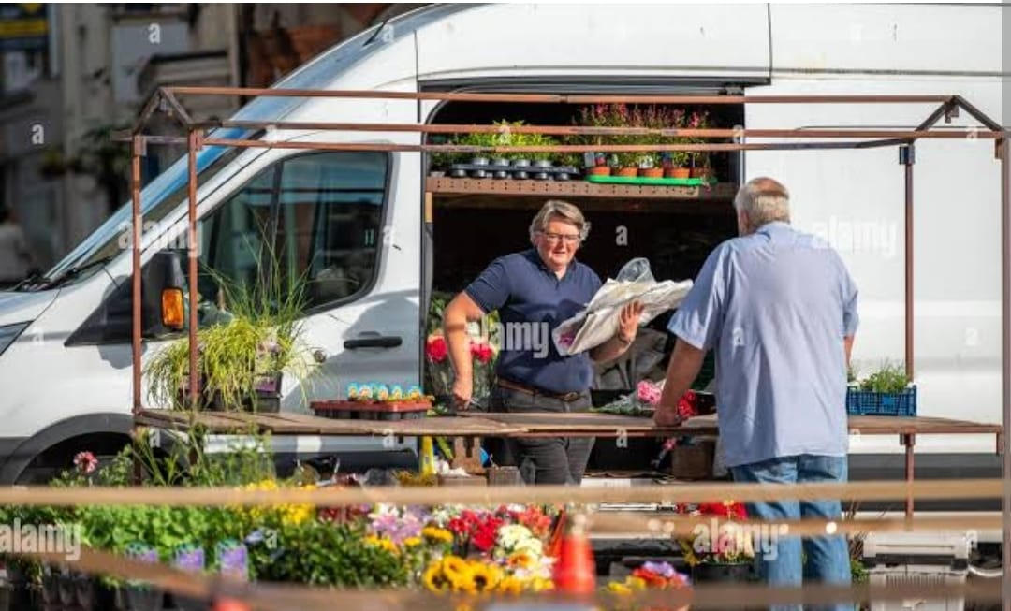
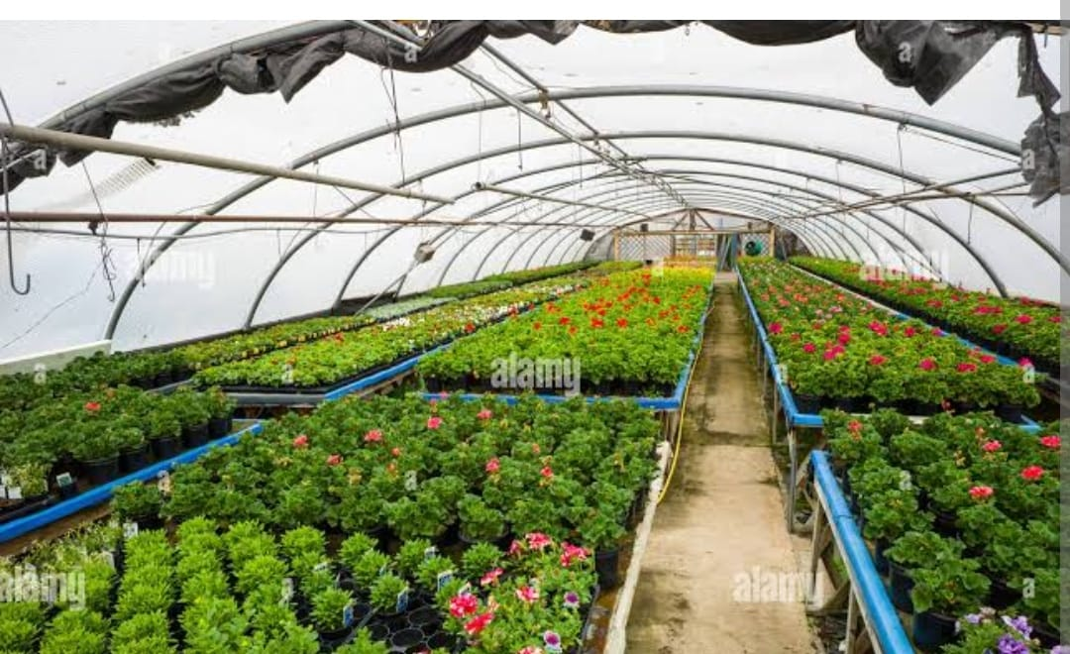
Existed system
NURSERY IN OUR SURROUNDINGS
We can buy plants near nurseries at our surroundings but sometimes they
may not be available near us or the required product may not be available at
that time .
PLANT SELLER GOES TO DIFFERENT AREAS TO SELL THE PLANTS
Plant seller need to travel different streets and different areas for selling plants
to the people who need. Sometimes the customers may not be present at that
time.
Notes:
9

Slide 10
Research Objective
Notes:
10

Slide 11
Research objective
The objectives is to develop an efficient application that will be helpful for not
only buyers but also for sellers.
Application development will be done according to the requirements of both
sellers and buyers.
To make direct communication between seller and buyer by this website and
save time and resources of people.

Slide 12
Problem Definition
Notes:
12

Slide 13
Problem Definition
Many people who want to buy plants will directly contact to the nursery and buy the plants but sometimes people doesn’t know specific information about particular plant items. Customer does not compare plant price with other shopkeepers at the same time .In nursery there is no facility for online payment only cash may be available. Limited customers reached to the nursery because sometimes customer need to travel for long distance as nursery is far from their home. The system has the provision of orders entered by the clients along with their contact details, special services, and amount of request. After an order is entered, an order confirmation report will be sent to the client for review. When all orders have been entered, a sale report will be created.

Slide 14
Research Work
Notes:
14

Slide 15
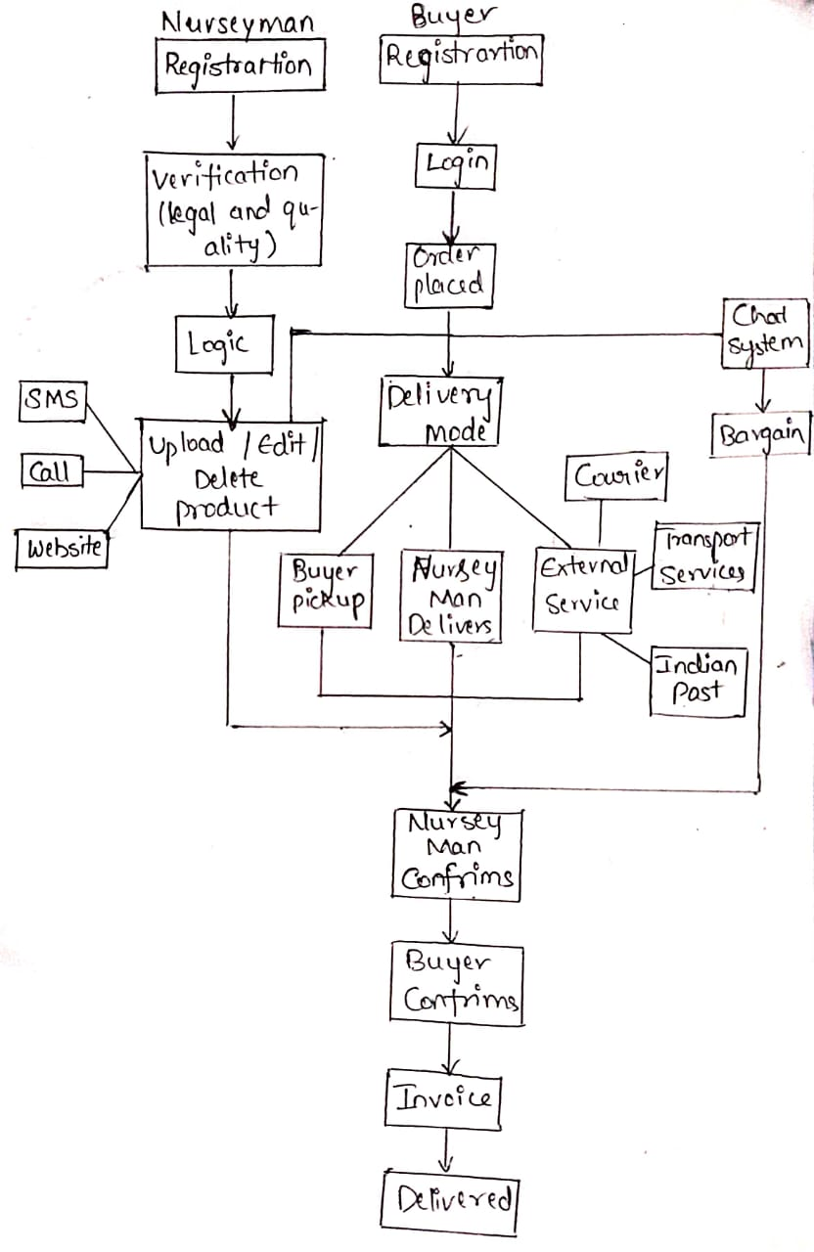
Proposed system architecture

Slide 16
Proposed Methods
our proposed model will leads to the accomplishment of the following results:
By the application customers can easily access the modules like online products
and get different range of products through this website.
2) The application is flexible and can easily access by the customers
3) The time will be reduced by online method.
The project will be developed by using the web technologies like HTML,
CSS,JAVA SCRIPT,BOOTSTRAP,MYSQL and PHP.

Slide 17
Performance Measure:
The performance compared to offline buying products, time taken process
will be reduced in there daily life.
In terms of performance of website online nursery has to be faster with where
your are you can explore the world with online buying products with mobile
or laptops.
The PHP 5.0 engine was completely redesigned with an optimized memory
manager to improve performance ,and is noticeable faster than previous
versions .in addition ,third party accelerators are available to further improve
performance and response time .

Slide 18
Result Analysis
The online nursery website helps in fulfilling the unique features
It provides good performance compared to other platforms and provides that
safe buying products in this website without any default in this website ,customers
can get products to them.
It provides portability (platform independent) as it works in UNIX Linux,
windows .It is easy of use as it syntax in clear and consistent and it is user-friendly.
This project is done with PHP as it supports more than 15 databases like
Like MySQL , Oracle, Microsoft SQL etc...

Slide 19
Conclusion
“Designing a website for online nursery” is discussed in this work ,the products is designed to solve the problem of buying plants. Generally it will be available in offline mode but we intention was to made it online then, it will be more useful for both seller and buyer, with less time to order and upload things in mobiles or laptops. This website built with PHP, MySQL, HTML and C.S.S it was hosted locally using XAMPP .The objectives like creation of database adding the data to database (MySQL)and running the website on XAMPP are achieved successfully.

Slide 20
Future work
In near future, the system interface could be improved With more attractive, interactive and Meaning images.
We evolve the system by developing sever versions through user feedback.
In future we will add new features to project like issuing of any products or any material related plants and provide the performance of the products .
When the new products are get then it notified to the customers through notification.

Slide 21
References
http://www.durgansc.com
https://sankalptaru.org/?gclid=CjwKCAjwh4ObBhAzEiwAHzZYU4ferr_jCQJYtTbtGqYygI-uC36XrC7tzmFR8_Re7PQbZcOHZoHqaRoCJPAQAvD_BwE
https://www.nurserylive.com.

Slide 22
Thank You!

